Slide 1
Hardware Trojans in Asynchronous FIFO-Buffers:
From Clock Domain Crossing Perspective
Akhil Reddy Gujju, Nicholas Green, Manideep Thotakura
Department of Electrical and Computer Engineering, University at Albany, SUNY
April 23, 2024

Slide 2
Outline
Threat Model
FIFO
FIFO Trojans
Defense against Trojan
Conclusion and Future Work

Slide 3
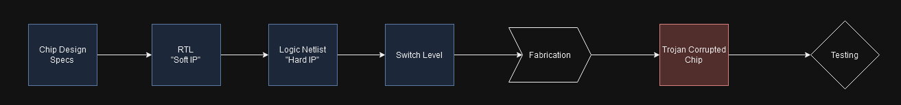
Denial of Service Attacks by Trojans
Three Main Goals:
Insert Trojan that breaks chip
Corrupting Data
Faulty Logic
Get the Trojan passed testing/detection phase

Slide 4
Denial of Service Attacks by Trojans
Two Main Goals:
Insert Trojan that breaks chip
Get the Trojan passed testing/detection phase
Device Trojans
(ex: dopant polarity modification)
RTL/Soft IP Trojan
(ex: RTL code modification)
Logic Trojans
(ex: rare event/input triggering)

Slide 5
Trojan Detection Strategies
Rare event/input testing

Slide 6
Trojan Detection Strategies
Known Secure Chip
Test Vectors
DUT
Signature Based Testing

Slide 7
Contributions
Two Main Contributions:
Lack of attacks on asynchronous logic
FIFO's are small making easier to hide the Trojan in the chip

Slide 8
Asynchronous Logic
CLK 1
"CPU"
CLK 2
"Memory Management Unit"
FIFO
You cannot connect units reading and writing at different clock speeds due to buffering and metastability of flip flops

Slide 9
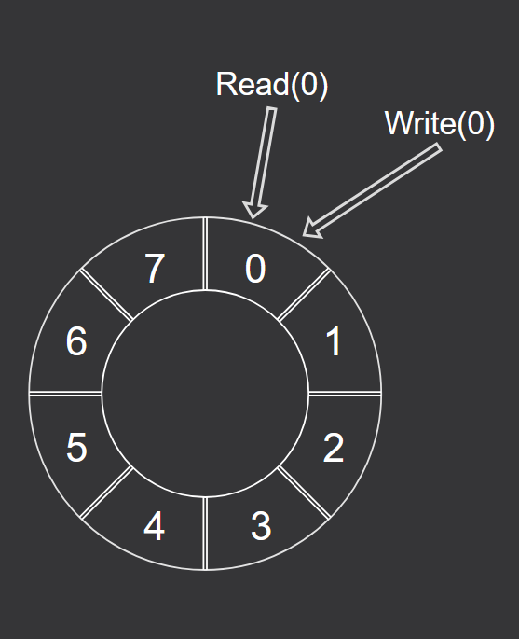
FIFO Basics
First-In First-Out
Ring Buffer
Write Pointer
Read Pointer

Slide 10
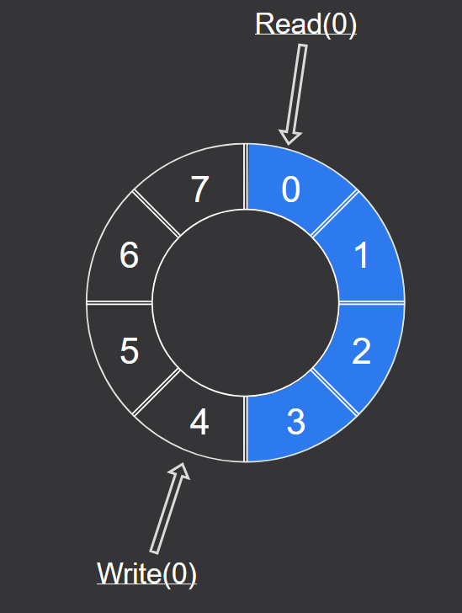
FIFO Basics:
Write Operation
Writing four words to the FIFO, write pointer increments each time leaving off at the next empty space

Slide 11
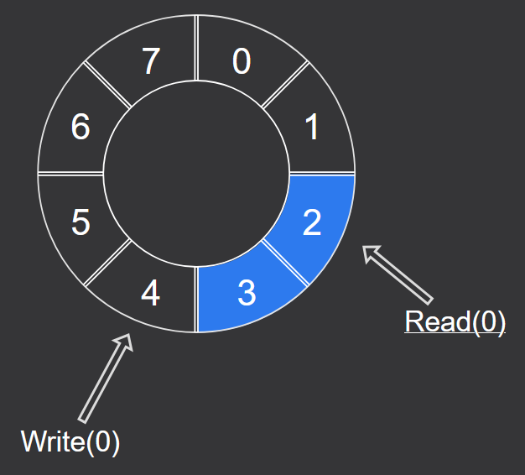
FIFO Basics
Read Operation
Read pointer reads word, clears the space, and then increments to the next available word

Slide 12
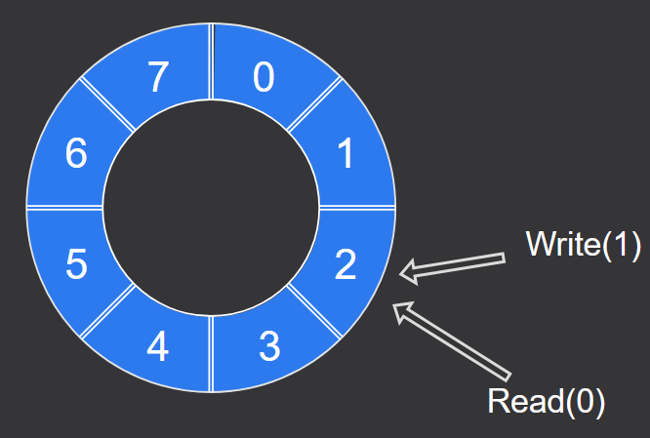
FIFO Basics
Full Condition:
Write: 1_010
Read: 0_010
If the read and write pointer occupy the same space but have different MSBs, the buffer must be full

Slide 13
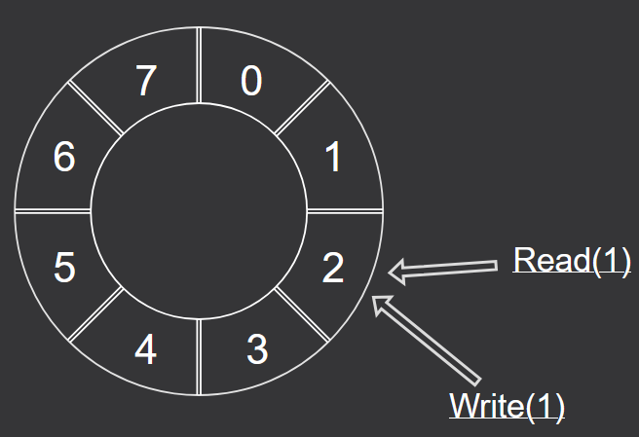
FIFO Basics
Empty Condition:
Write: 1_010
Read: 1_010
If the read and write pointer occupy the same space and have the same MSBs, the buffer must be empty

Slide 14
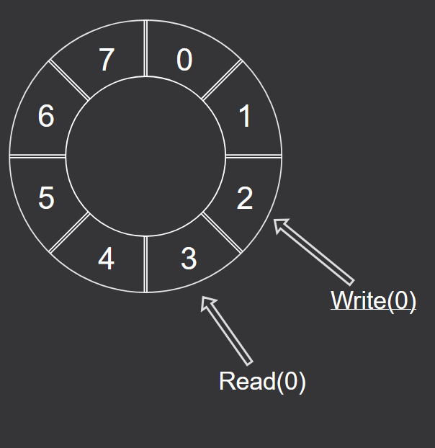
FIFO Basics
Illegal States:
The read buffer can never read ahead of the write
The write buffer can never overwrite data and go ahead of the read

Slide 15
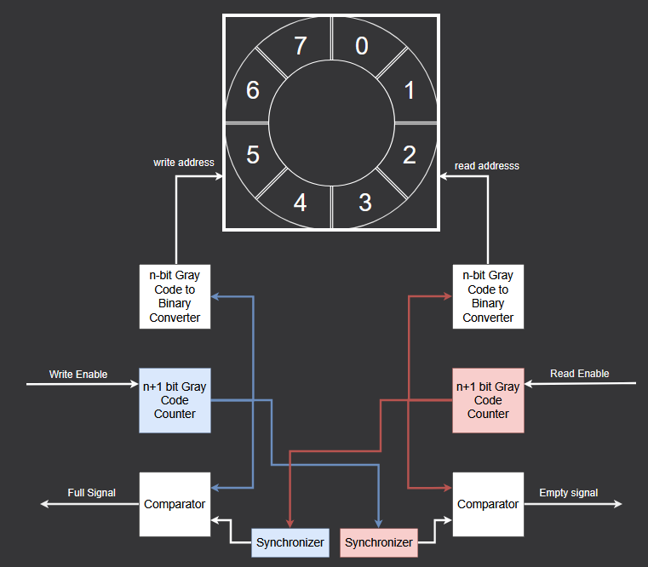
FIFO Structure

Slide 16
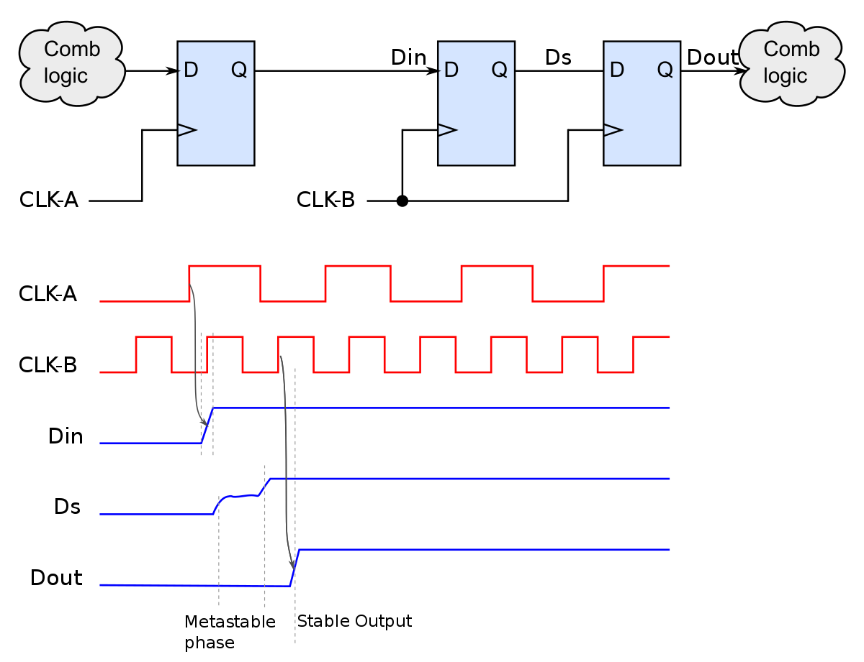
Crossing Clock Domains
https://en.wikipedia.org/wiki/Metastability_(electronics)?oldformat=true

Slide 17
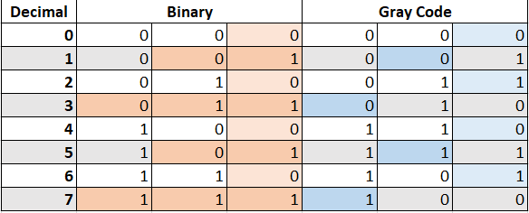
Gray Codes
Binary codes can have multiple bit changes where Gray codes ensure only one bit is changed. This works for addressing because we know the addresses are sequential, so we can guarantee a single bit change

Slide 18
FIFO Trojans
Trojan I : Undetectable illegal State
Trojan II : Exploiting illegal State
Trojan III: Erroneous but legal State
Trojan IV: Exploiting Rare Pointer Combinations

Slide 19
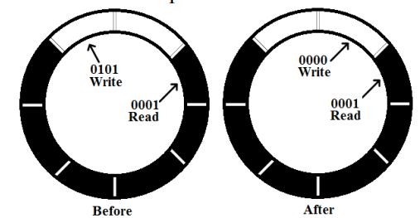
Trojan I: Undetectable Illegal State
A FIFO write control unit can unintentionally enter an undetectable illegal state when the write pointer resets to a location behind the read pointer.
Normal State: wr_ptr ‘0101’ & r_ptr‘0001’.
Illegal State: wr_ptr ‘0000’ & r_ptr‘0001’.
In this situation, the write pointer can be unexpectedly reset to ‘0000’.
process(clkw, resetw)
begin
if((resetw='1') OR (w_ptr_reg="0101" AND r_ptr_in="0001")) then
w_ptr_reg<= (others=>'0');
elsif (clkw'EVENT and clkw='1') then
w_ptr_reg <= w_ptr_next;
end if;
end process;

Slide 20
Trojan I​​: Undetectable Illegal State
Both pointers end up in the same loop, which is an illegal condition.
Conventional FIFO designs assume that such a condition is impossible.
Consequently, no provisions are made to handle or rectify this case.
​
process(clkw, resetw) ​
Begin ​
if((resetw='1') OR (w_ptr_reg="0101" AND r_ptr_in="0001"))then
w_ptr_reg <= (others=>'0'); ​
elsif (clkw'EVENT and clkw='1') then ​
w_ptr_reg <= w_ptr_next; ​
end if; ​
end process; ​

Slide 21
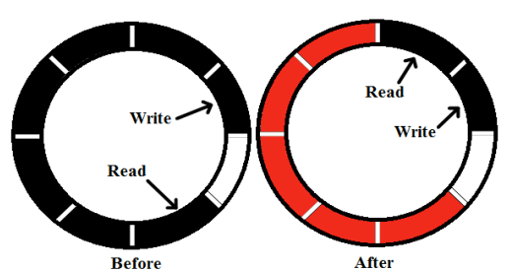
Trojan I​I: Exploiting Illegal States
Assumption: The write pointer has started the second loop (MSB=1), while read pointer is still in the middle of the first loop (MSB=0).
Normal State: wr_ptr ‘1101’ & r_ptr‘0010’.
Illegal State: wr_ptr ‘1101’ & r_ptr‘0000’.
If an intrusion occurs and resets the read pointer to ‘0000’, the read pointer won’t be able to read beyond the write pointer.
process(clkr, resetr)
begin
if ((resetr = '1') or (r_ptr_reg = "0010" and w_ptr_in = "1101")) then
r_ptr_reg <= (others => '0');
elsif clkr'EVENT and clkr = '1' then
r_ptr_reg <= r_ptr_next;
end if;
end process;

Slide 22
Trojan I​I: Exploiting Illegal States
All data written in buffer locations shown in red will eventually be overwritten.
Traditional FIFO designs assume that this condition (read pointer lagging behind write pointer) is impossible.
As a result, they do not provide a rectification mechanism to handle such situations.
process(clkr, resetr)
begin
if ((resetr = '1') or (r_ptr_reg = "0010" and w_ptr_in = "1101")) then
r_ptr_reg <= (others => '0');
elsif clkr'EVENT and clkr = '1' then
r_ptr_reg <= r_ptr_next;
end if;
end process;

Slide 23
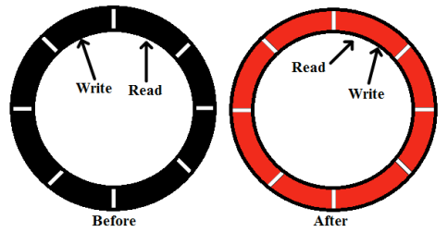
Trojan I​II: Erroneous but Legal State
Trojan III arises from an erroneous but legal state due to improper flipping of the wraparound bit.
After first write cycle, the write pointer is reinstated to the value of the current read pointer without flipping the MSB of the write pointer.
process(clk, resetn)
begin
if ((resetn = '1') OR (w_ptr_reg = "0100" AND r_ptr_out = "0000")) then
w_ptr_req <= (others => '0');
elsif (clk'EVENT and clk = '1') then
w_ptr_req <= w_ptr_next;
end if;
end process;

Slide 24
Trojan I​II: Erroneous but Legal State
Consequences:
If the memory array is filled with data and the read unit is still at the first address, normal operation should generate a full signal via the write unit.
However, malicious alteration prevents the MSB of the write pointer from flipping, resulting in all data being overwritten.
Modification:
If, after the ‘if’ statement is asserted, r_ptr_out is incremented, w_ptr_reg will contain a lesser value than the read pointer.
This case may lead to an illegal scenario like Trojan I, which remains undetectable in traditional FIFO circuits.

Slide 25
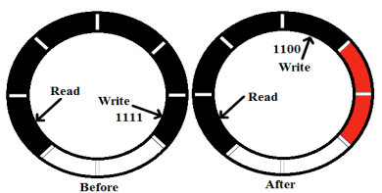
Trojan IV: Exploiting Rare Pointer Combinations
The Trojan is inserted based on any random combination of read and write pointers.
Example: Read pointer at ‘0111’ and write pointer at ‘1111’.
Requires relatively higher code alteration but remains small compared to a complete digital design.
process(clkw, resetw)
begin
if (resetw = '1') then
w_ptr_reg <= (others => '0');
elsif (clkw'EVENT and clkw = '1') then
w_ptr_reg <= w_ptr_next;
if (w_ptr_reg = "1111" AND r_ptr_out = "0111") then
w_ptr_reg(N-1) <= '1';
w_ptr_reg(N-2 downto 0) <= (others => '0');
end if;
end if;
end process;

Slide 26
Trojan IV: Exploiting Rare Pointer Combinations
Factors Affecting Pointer Differences:
Depth of the FIFO memory array.
Clock frequency ratio.
Data exchange frequency between sender and receiver.
process(clkw, resetw)
begin
if (resetw = '1') then
w_ptr_reg <= (others => '0');
elsif (clkw'EVENT and clkw = '1') then
w_ptr_reg <= w_ptr_next;
if (w_ptr_reg = "1111" AND r_ptr_out = "0111") then
w_ptr_reg(N-1) <= '1';
w_ptr_reg(N-2 downto 0) <= (others => '0');
end if;
end if;
end process;

Slide 27
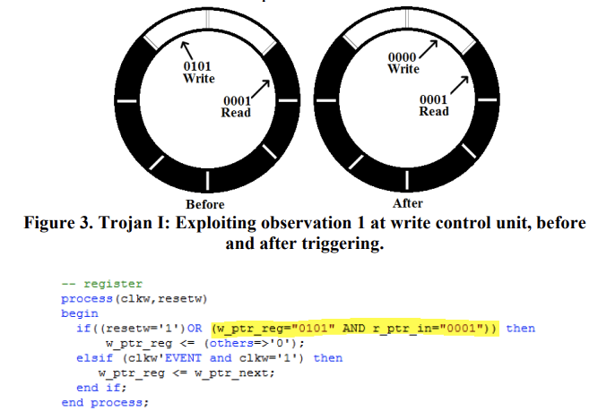






Additional Trojan that breaks chip
Illegal state
Our proposed Illegal state
0000
Read
0111
Write
0101
Read
0111
Write
If ((resetw='1') or (w_ptr_reg="0111" and r_ptr_in="0000")) then
r_ptr_reg <= "0101"

Slide 28
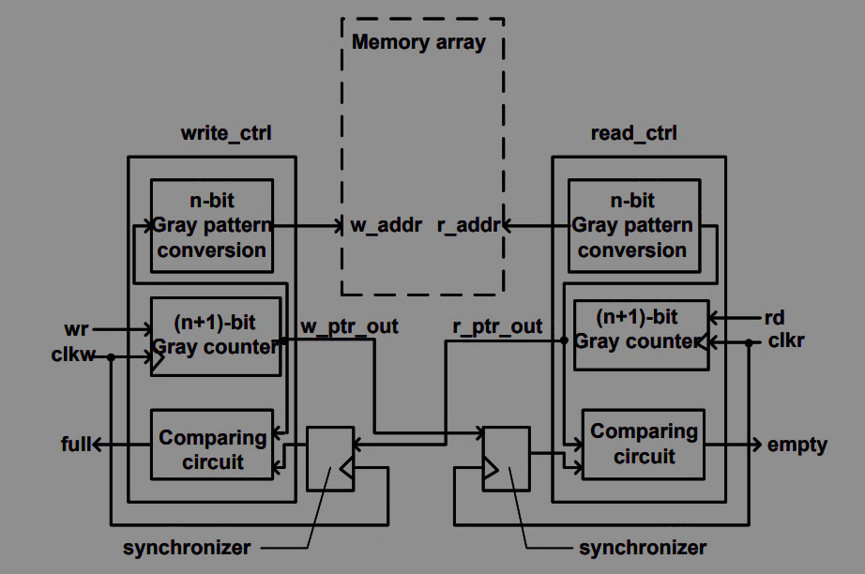

Suggested Defense
Check before pass
To Find the fault condition of trojan
To prevent break down from illegal sates
To prevent data manipulation
Contributions

Slide 29
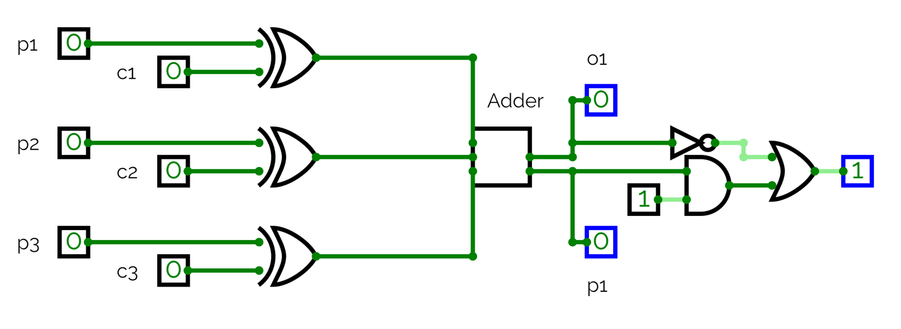
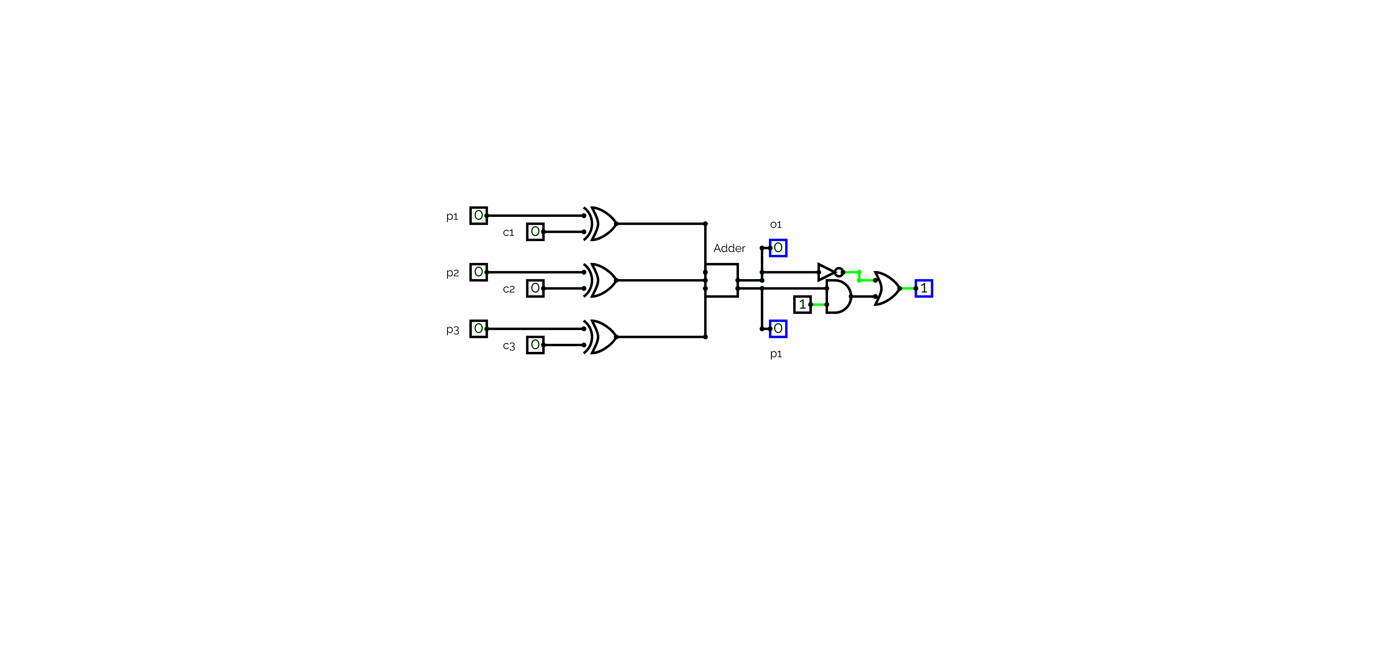
Defense circuit
Demo
SUM
CARRY
​

Slide 30



Prev LSB address : 101
Current LSB address : 100
Xor (101, 100) = 001
Adder(0,0,1) = 1 (binary : 01)
Input 1 | Input 2 | output
0 | 0 | 0
0 | 1 | 1
1 | 0 | 1
1 | 1 | 0
Prev LSB address : 101
Current LSB address : 110
Xor (101, 100) = 011
Adder(0,0,1) = 2 (binary : 10)

Slide 31
For MSB bit:
If(previous_LSB = 100 ):
if(MSB = ~Prev_MSB):
PASS
Else :
Our_Method()
Brute force functionality check:
N(N-1) possibilities
Our Method():
store_adress()
Current_LSB = gray_count(Prev_LSB)
Current_MSB = Prev_MSB

Slide 32
Benefits of Defense​
What if a trojan exist?
Hardware
Testing Time
Sanity check
Code Bugs
Drawbacks of Defense
What if no trojan exist?
Timing Delay
Power loss
Area loss
Temperature

Slide 33
Conclusion and Future work
Vulnerability in Traditional FIFO Buffers:
Adversaries can exploit these weaknesses to introduce undetectable hardware Trojans.
Soft IP Security Concerns:
Unauthorized access to soft IP could enable the insertion of malicious hardware Trojans, posing a significant security risk.
Impact on Hardware:
Compared to unmodified FIFOs, intruded versions show a footprint increase of 4% to 14% and a delay variation (Fmax) of 6% to 21%.

Slide 34
Conclusion and Future work
Suggested Mitigation Strategies at Various levels:
Protocol Level: Consider secure communication protocols.
System Level: Implement robust security measures.
Gate Level: Enhance gate-level security to prevent Trojan insertion.
Future Research:
The authors recommend further research on other types of clock domain crossing (CDC) techniques to fully understand the threat landscape in multi-clock domain integrated circuits.

Slide 35
Thank You
Any Questions?

